Slide 1

Week-2
Lecture 3

Slide 2
Lecture Content
Memory allocation for class, objects

Slide 3
Memory allocation for class, objects
When we define class it will not allocate memory space for the data member of the class.
The memory allocation for the data member of the class is performed separately each time when an object of the class is created.

Slide 4
Memory allocation for class, objects
Member functions defined inside class are same for all objects, but memory allocation for member function is performed at the time of defining the class.
Memory allocation is performed separately for different object of the same class.
All the data members of each object will have separate memory space

Slide 5
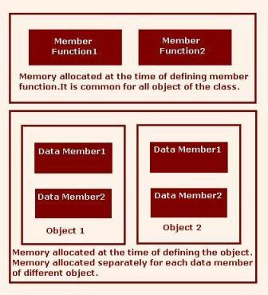
Memory allocation for class, objects

Slide 6
Memory Allocation
There are essentially two types of memory allocation
  Static – Done by the compiler automatically (implicitly).
    Global variables or objects -- memory is allocated at the start of the program, and freed when program exits; alive throughout program execution
      Can be access anywhere in the program.
    Local variables (inside a routine) – memory is allocated when the routine starts and freed when the routine returns.
      A local variable cannot be accessed from another routine.
    Allocation and free are done implicitly.
    No need to explicitly manage memory is nice (easy to work with), but has limitations!
      Using static allocation, the array size must be fixed.
        Consider the grade roster for the class? What is the number of people in the class?

Slide 7
Memory Allocation
There are essentially two types of memory allocation
  Wouldn’t it be nice to be able to have an array whose size can be adjusted depending on needs.
    Dynamic memory allocation deals with this situation.
  Dynamic – Done explicitly by programmer.
    Programmer explicitly requests the system to allocate memory and return starting address of memory allocated (what is this?). This address can be used by the programmer to access the allocated memory.
    When done using memory, it must be explicitly freed.

Slide 8
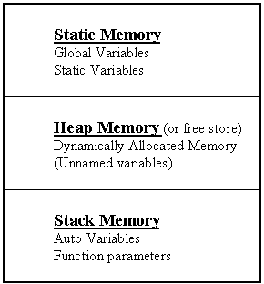
Memory Allocation
In C and C++, three types of memory are used by programs:
Static memory - where global and static variables live
Heap memory - dynamically allocated at execution time
- "managed" memory accessed using pointers
Stack memory - used by automatic variables

Slide 9
3 Kinds of Program Data
STATIC DATA: Allocated at compiler time
DYNAMIC DATA: explicitly allocated and deallocated during program execution by C++ instructions written by programmer using operators new and delete
AUTOMATIC DATA: automatically created at function entry, resides in activation frame of the function, and is destroyed when returning from function

Slide 10
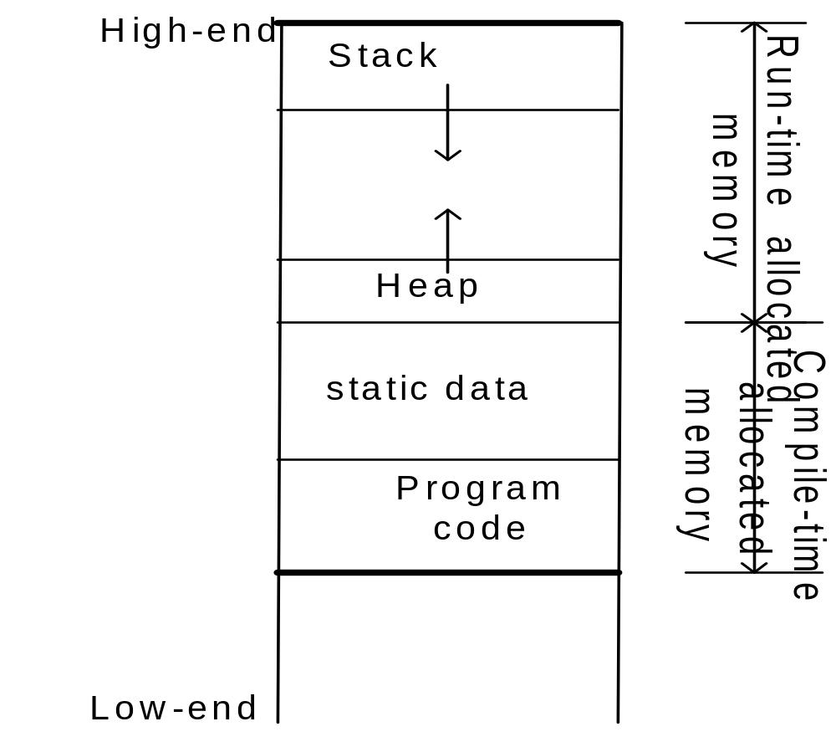
Dynamic Memory Allocation Diagram

Slide 11
Dynamic Memory Allocation
In C, functions such as malloc() are used to dynamically allocate memory from the Heap.
In C++, this is accomplished using the new and delete operators
new is used to allocate memory during execution time
  returns a pointer to the address where the object is to be stored
  always returns a pointer to the type that follows the new

Slide 12
The Heap
Large area of memory controlled by the runtime system that is used to grant dynamic memory requests.
It is possible to allocate memory and “lose” the pointer to that region without freeing it. This is called a memory leak.
A memory leak can cause the heap to become full
If an attempt is made to allocate memory from the heap and there is not enough, an exception is generated (error)
sample5.cpp

Slide 13
Why use dynamic memory allocation?
Allows data (especially arrays) to take on variable sizes (e.g. ask the user how many numbers to store, then generate an array of integers exactly that size).
Allows locally created variables to live past end of routine.
Allows us to create many structures used in Data Structures and Algorithms
sample6.cpp
sample7_1.cpp
sample7.cpp

Slide 14
Explicit memroy allocation/free in C (Works also in C++)
The malloc and free routines
  Prototype defined in stdlib.h
  malloc is similar to new except that it specifies the exact memory size
    Return a (void *) -- needs to convert to the right pointer type
  free is equivalent to delete (only one form for both single item and many items).

Slide 15
Thank You

